Slide 1
Materials Science and Engineering at NC State
Click Here

Slide 2
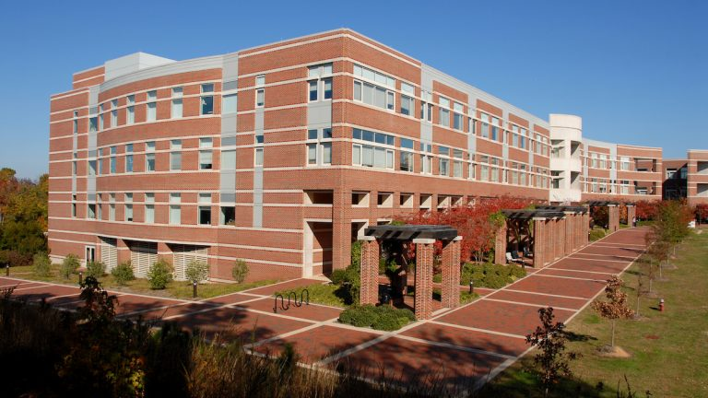
Quick Statistics
Our Students
50 students/year
35% Female
3.40 GPA
After Graduation
$70,729 Salary
46.1% accepted jobs before graduation
23% go to graduate school
Our School
Ranked 19th in MSE
US News & World Reports

Slide 3
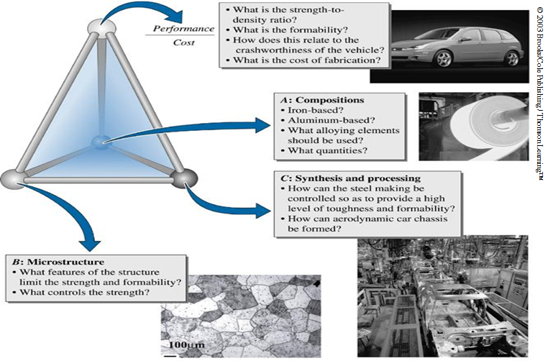
What is MSE?
"My desire to impact the world in a positive manner drove me to choose MSE. What better way to change the world for the better than to influence technology at its core: The materials that drive the physics and the chemistry."
-Aaron Lando

Slide 4
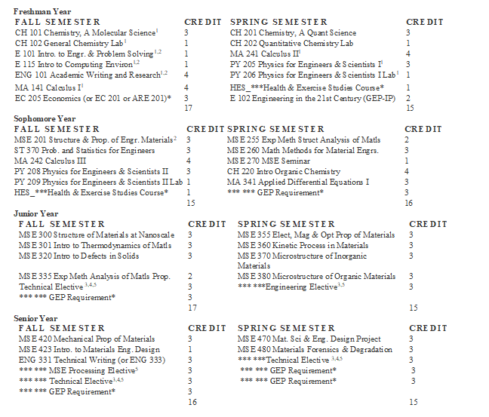
Courses You Will Take
“MSE is great because we take classes on a wide variety of topics, intersecting with different departments, to match the interdisciplinary nature of our future careers”
-Yue Zhang

Slide 5
Job Experience
Work Related Experiences
Internship (69.2%)
Research (65.4%)
Class Projects (46.2%)
Lab Courses (100%)
Senior Design (100%)
“The MSE department stands out for giving students hands-on, relevant experience. I have had undergraduate research positions that dealt with energy storage materials, polymers, and metals. Our lab courses teach useful skills. These resources have made me confident in what I want to do in the future.”
- Ellie Scott

Slide 6
Our Community
15:1 student to faculty ratio
Professors know students by name
Know and collaborate with peers
Take the classes at the same times
Makes a large university feel smaller
"MSE means family to me. Being part of a small department, you are able to form strong (covalent) bonds with your classmates.“
-Carmen Procida

Slide 7
More Information
Brochure:
https://www.mse.ncsu.edu/wp-content/uploads/2019/04/UGBrochure_web.pdf
Website for Prospective Students:
https://www.mse.ncsu.edu/undergaduate-prospective-students/

